Slide 1
Communication Techniques

Slide 2
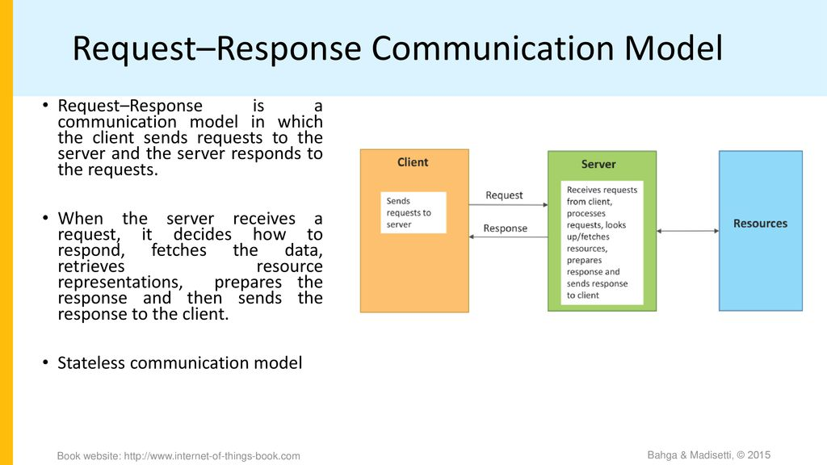

Slide 3
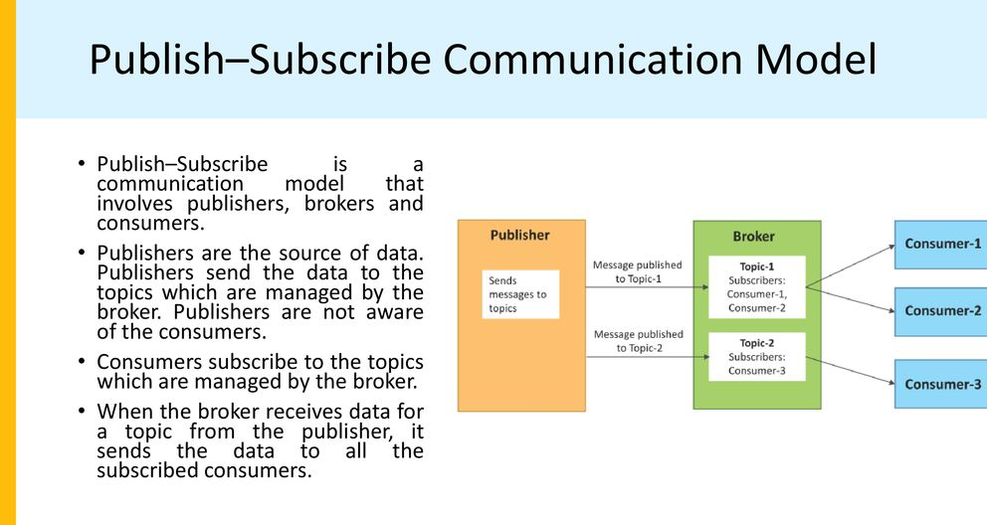

Slide 4
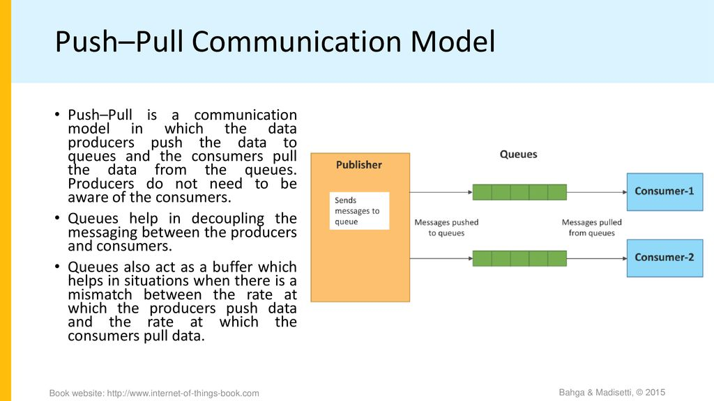

Slide 5
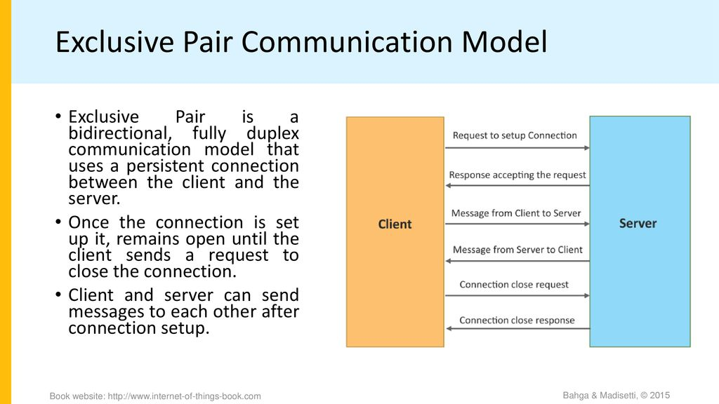

Slide 6
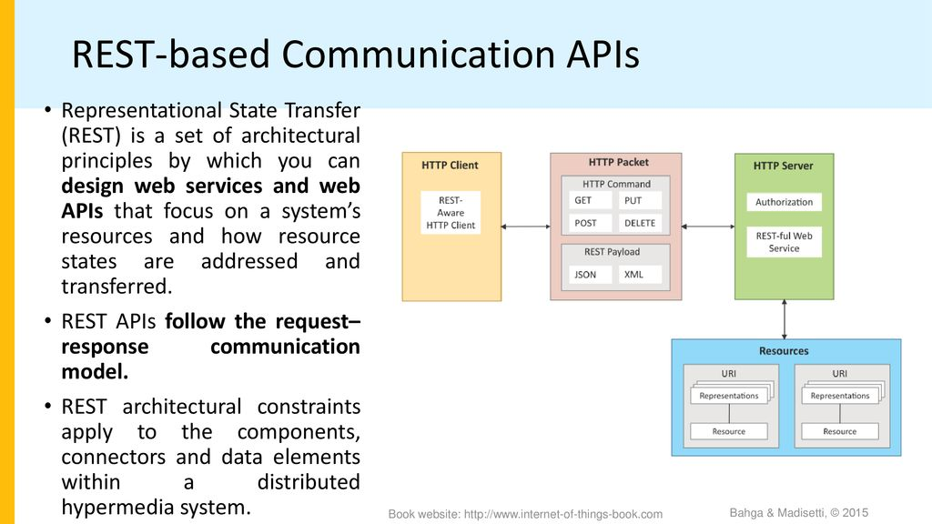
cccccccccccccccccccccccccccccccccccccccccccccccc

Slide 7
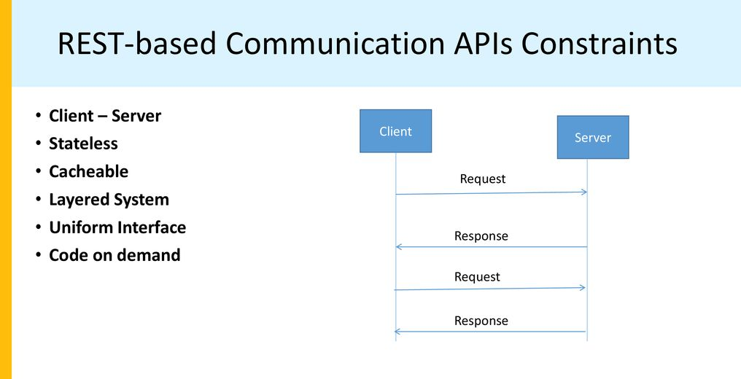

Slide 8
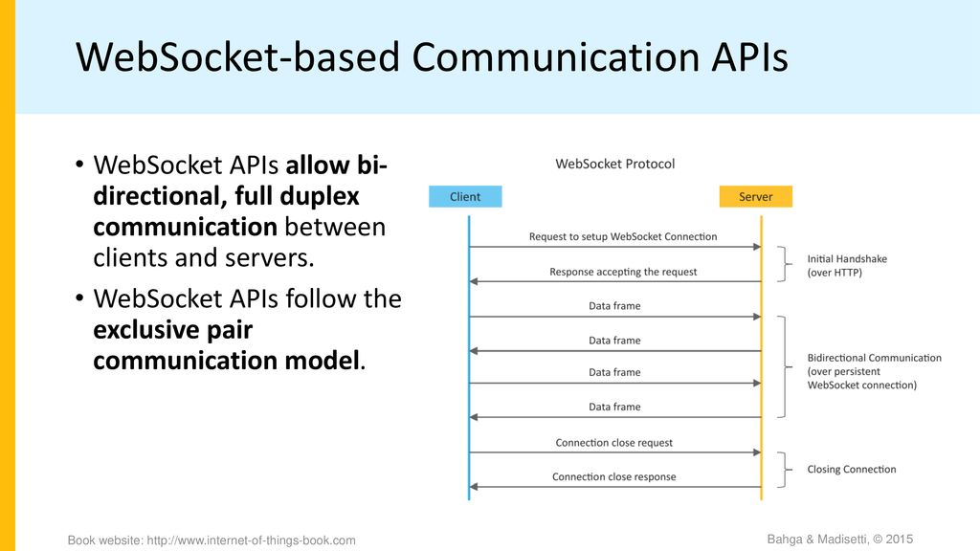

Slide 9
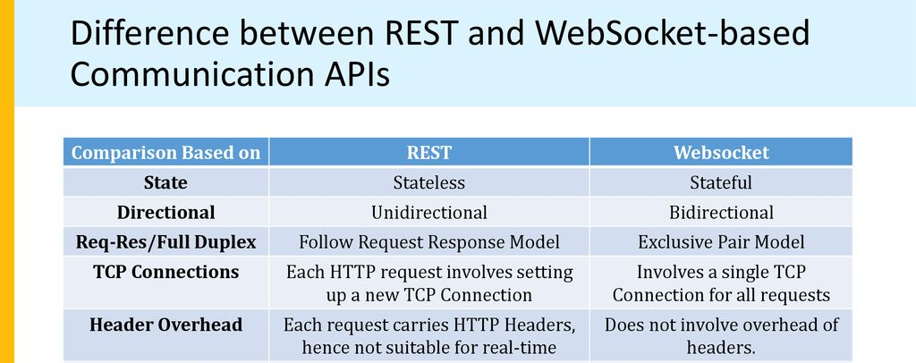

Slide 10
The physical layer uses on of the following technologies for communication
Wireless communication
Wired communication

Slide 11
Wireless communication
NFC( Near Field communication)
RFID
Bluetooth
ZigBee
Wi-Fi
GPRS/GSM cellular Network-Mobile Internet
Wireless USB

Slide 12
RF Technology
Radio frequency (RF) refers to the rate of oscillation of electromagnetic radio waves in the range of 3 kHz to 300 GHz, as well as the alternating currents carrying the radio signals.
This is the frequency band that is used for communications transmission and broadcasting. Although RF really stands for the rate of oscillation of the waves, it is synonymous to the term "radio," or simply wireless communication.

Slide 13
Radio frequency is being used in a lot of fields, but in the context of information and communications technology it refers to the frequency band at which wireless telecommunications signals are being transmitted and broadcast.
The frequency band is being divided into different parts, which are then assigned to different technology industries. This is known as the radio spectrum.
For example, the VHF (very high frequency) band, which ranges from 30-300 MHz, is being used for FM radio, TV broadcasts, and amateur radio and its counterparts.
For a lot of electronic communication devices, the ultra-high frequency (UHF) band is being used.
This is the space used by mobile phones, wireless LAN, Bluetooth, and TV and land radio.

Slide 14
Radio frequency is produced by oscillating current a specified number of times and then radiating it off a conductor, referred to as an antenna, into empty space (this refers to space occupied by air rather than solid objects and does not refer to outer space) as electromagnetic radio waves.
RF signals are sent and received using conductors through the phenomenon known as the skin effect, where RF current latches itself and flows through the surface of conductors rather than penetrating and passing through them like it does with other non-conducting solids.
This effect is the core and basis of radio technology.

Slide 15
NFC
NFC stands for “Near Field Communication” and, as the name implies, it enables short-range communication between compatible devices. This requires at least one transmitting device, and another to receive the signal. A range of devices can use the NFC standard and will be considered either passive or active.
Passive NFC devices include tags, and other small transmitters, that can send information to other NFC devices without the need for a power source of their own. However, they don’t process any information sent from other sources, and can’t connect to other passive components.
Active devices are able to both send and receive data, and can communicate with each other as well as with passive devices. Smart phones are by far the most common form of active NFC device.
Public transport card readers and touch payment terminals are also good examples of the technology.

Slide 16
NFC works on the principle of sending information over radio waves. Near Field Communication is another standard for wireless data transitions. This means that devices must adhere to certain specifications in order to communicate with each other properly. The technology used in NFC is based on older RFID (Radio-frequency identification) ideas,
The transmission frequency for data across NFC is 13.56 megahertz. You can send data at either 106, 212, or 424 kilobits per second. That’s is quick enough for a range of data transfers — from contact details to swapping pictures and music.
Range of functioning is within 10 to 20 cms

Slide 17
To determine what sort of information will be exchanged between devices, the NFC standard currently has three distinct modes of operation.
Perhaps the most common use in smart phones is the peer-to-peer mode. This allows two NFC-enabled devices to exchange various pieces of information between each other. In this mode, both devices switch between active when sending data and passive when receiving.
Read/write mode, on the other hand, is one-way data transmission. The active device, possibly your smart phone, links up with another device in order to read information from it. NFC advert tags use this mode.
The final mode of operation is card emulation. The NFC device can function as a smart or contactless credit card and make payments or tap into public transport systems.

Slide 18
RFID
RFID is an acronym for “radio-frequency identification” and refers to a technology whereby digital data encoded in RFID tags or smart labels (defined below) are captured by a reader via radio waves.
RFID is similar to barcoding in that data from a tag or label are captured by a device that stores the data in a database.
RFID, however, has several advantages over systems that use barcode asset tracking software.
The most notable is that RFID tag data can be read outside the line-of-sight, whereas barcodes must be aligned with an optical scanner.

Slide 19
HOW DOES RFID WORK?
RFID belongs to a group of technologies referred to as Automatic Identification and Data Capture (AIDC).
AIDC methods automatically identify objects, collect data about them, and enter those data directly into computer systems with little or no human intervention.
RFID methods utilize radio waves to accomplish this.
At a simple level, RFID systems consist of three components: an RFID tag, an RFID reader, and an antenna. RFID tags contain an integrated circuit and an antenna, which are used to transmit data to the RFID reader (also called an interrogator).
The reader then converts the radio waves to a more usable form of data. Information collected from the tags is then transferred through a communications interface to a host computer system, where the data can be stored in a database and analyzed at a later time.

Slide 20
RFID TAGS
As stated above, an RFID tag consists of an integrated circuit and an antenna.
The tag is also composed of a protective material that holds the pieces together and shields them from various environmental conditions.
The protective material depends on the application. For example, employee ID badges containing RFID tags are typically made from durable plastic, and the tag is embedded between the layers of plastic.
RFID tags come in a variety of shapes and sizes and are either passive or active.
Passive tags are the most widely used, as they are smaller and less expensive to implement. Passive tags must be “powered up” by the RFID reader before they can transmit data. Unlike passive tags, active RFID tags have an onboard power supply (e.g., a battery), thereby enabling them to transmit data at all times.

Slide 21
Bluetooth
Bluetooth is a short-range wireless communication technology that allows devices such as mobile phones, computers, and peripherals to transmit data or voice wirelessly over a short distance.
The purpose of Bluetooth is to replace the cables that normally connect devices, while still keeping the communications between them secure.
The "Bluetooth" name is taken from a 10th-century Danish king named Harald Bluetooth, who was said to unite disparate, warring regional factions. Like its namesake, Bluetooth technology brings together a broad range of devices across many different industries through a unifying communication standard.

Slide 22
A Bluetooth technology is a high speed low powered wireless technology link that is designed to connect phones or other portable equipment together. It is a specification (IEEE 802.15.1) for the use of low power radio communications to link phones, computers and other network devices over short distance without wires. Wireless signals transmitted with Bluetooth cover short distances, typically up to 30 feet (10 meters).
It is achieved by embedded low cost transceivers into the devices. It supports on the frequency band of 2.45GHz and can support upto 721KBps along with three voice channels. This frequency band has been set aside by international agreement for the use of industrial, scientific and medical devices (ISM).rd-compatible with 1.0 devices.
Bluetooth can connect up to “eight devices” simultaneously and each device offers a unique 48 bit address from the IEEE 802 standard with the connections being made point to point or multipoint.

Slide 23
Versions
The first version was 1.2 standard with a data rate speed of 1Mbps.
The second version was 2.0+EDR with a data rate speed of 3Mbps.
The third was 3.0+HS with speed of 24 Mbps. The latest version is 4.0.

Slide 24
Bluetooth creates a 10-meter (33-foot) radius wireless network, called a personal area network (PAN) or piconet, which can network between two and eight devices.
This short-range network allows you to send a page to your printer in another room, for example, without having to run an unsightly cable.
Bluetooth uses less power and costs less to implement than Wi-Fi. Its lower power also makes it far less prone to suffering from or causing interference with other wireless devices in the same 2.4GHz radio band.

Slide 25
Bluetooth range and transmission speeds are typically lower than Wi-Fi (the wireless local area network that you may have in your home). Bluetooth v3.0 + HS — Bluetooth high-speed technology — devices can deliver up to 24 Mbps of data, which is faster than the 802.11b WiFi standard, but slower than wireless-a or wireless-g standards. As technology has evolved, however, Bluetooth speeds have increased.
The Bluetooth 4.0 specification was officially adopted on July 6, 2010. Bluetooth version 4.0 features include low energy consumption, low cost, multivendor interoperability, and enhanced range.
The hallmark feature enhancement to the Bluetooth 4.0 spec is its lower power requirements; devices using Bluetooth v4.0 are optimized for low battery operation and can run off of small coin-cell batteries, opening up new opportunities for wireless technology. Instead of fearing that leaving Bluetooth on will drain your cell phone's battery, for example, you can leave a Bluetooth v4.0 mobile phone connected all the time to your other Bluetooth accessories.

Slide 26
Connecting With Bluetooth
Many mobile devices have Bluetooth radios embedded in them. PCs and some other devices that do not have built-in radios can be Bluetooth-enabled by adding a Bluetooth dongle, for example.
The process of connecting two Bluetooth devices is called "pairing." Generally, devices broadcast their presence to one another, and the user selects the Bluetooth device they want to connect to when its name or ID appears on their device. As Bluetooth-enabled devices proliferate, it becomes important that you know when and to which device you're connecting, so there may be a code to enter that helps ensure you're connecting to the correct device.
This pairing process can vary depending on the devices involved. For example, connecting a Bluetooth device to your iPad can involve different steps from those to pair a Bluetooth device to your car.

Slide 27
Advantages of Bluetooth Technology
It removes the problem of radio interference by using a technique called Speed Frequency Hopping. This technique utilizes 79 channels of particular frequency band, with each device accessing the channel for only 625 microseconds, i.e. the device must toggle between transmitting and receiving data from one time slot to another.. This ensures that the interference won’t take place as each transmitter will be on different frequencies.
The power consumption of the chip (consisting of transceiver) is low, at about 0.3mW, which makes it possible for least utilization of battery life.
It guarantees security at bit level. The authentication is controlled using a 128bit key.
It is possible to use Bluetooth for both transferring of data and verbal communication as Bluetooth can support data channels of up to 3 similar voice channels.
It overcomes the constraints of line of sight and one to one communication as in other mode of wireless communications like infrared.

Slide 28
Bluetooth Limitations
There are some downsides to Bluetooth. The first is that it can be a drain on battery power for mobile wireless devices like smartphones, though as the technology (and battery technology) has improved, this problem is less significant than it used to be.
Also, the range is fairly limited, usually extending only about 30 feet, and as with all wireless technologies, obstacles such as walls, floors, or ceilings can reduce this range further.
The pairing process may also be difficult, often depending on the devices involved, the manufacturers, and other factors that all can result in frustration when attempting to connect.

Slide 29
How Secure Is Bluetooth?
Bluetooth is considered a reasonably secure wireless technology when used with precautions. Connections are encrypted, preventing casual eavesdropping from other devices nearby. Bluetooth devices also shift radio frequencies often while paired, which prevents easy invasion.
Devices also offer a variety of settings that allow the user to limit Bluetooth connections. The device-level security of "trusting" a Bluetooth device restricts connections to only that specific device. With service-level security settings, you can also restrict the kinds of activities your device is permitted to engage in while on a Bluetooth connection.

Slide 30
Bluetooth Network consists of a Personal Area Network or a piconet which contains a minimum of 2 to maximum of 8 bluetooth peer devices- Usually a single master and upto 7 slaves.
A master is the device which initiates communication with other devices. The master device governs the communications link and trafﬁc between itself and the slave devices associated with it.
A slave device is the device that responds to the master device. Slave devices are required to synchronize their transmit/receive timing with that of the masters.
In addition, transmissions by slave devices are governed by the master device (i.e., the master device dictates when a slave device may transmit).
Speciﬁcally, a slave may only begin its transmissions in a time slot immediately following the time slot in which it was addressed by the master, or in a time slot explicitly reserved for use by the slave device.

Slide 31
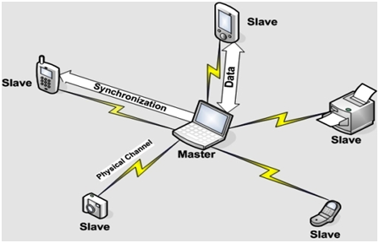

Slide 32
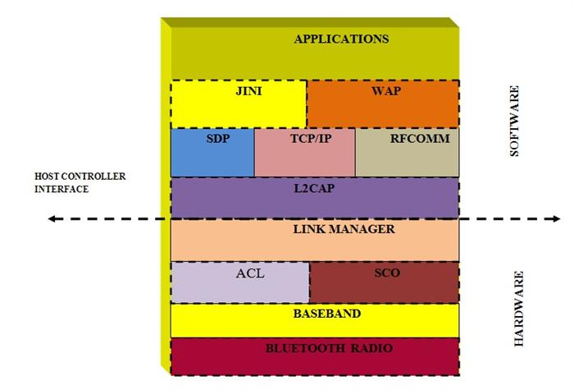

Slide 33
RADIO
The Bluetooth radio operates in 2.4 GHz ISM band. In US and Europe, a band of 83.5 MHz is available.
There are 79 channels spaced 1 MHz apart. Japan, Spain and France use only 23 channels spaced 1 MHz apart.
Radio speciﬁes the requirements for radio transmission – including frequency, modulation, and power characteristics – for a Bluetooth transceiver.

Slide 34
Bluetooth core protocols

Slide 35
Baseband
This is the most important part of Bluetooth protocol. Baseband is the physical layer of Bluetooth which manages physical channels and links. Baseband lies on top of Bluetooth radio.
It deﬁnes physical and logical channels and link types (voice or data); speciﬁes various packet formats, transmit and receive timing, channel control, and the mechanism for frequency hopping (hop selection) and device addressing. It specifies point to point or point to multipoint links. The length of a packet can range from 68 bits (shortened access code) to a maximum of 3071 bits.
Link controller wisely chooses the links and channels to be used and improves the performance of applications. It synchronizes with the layer above it i.e. link manager for carrying out link level routines like link connections and power control. On receiver side it performs error detection, data whitening, hop selection and Bluetooth security.
Baseband also manages links, handles packets and does paging and inquiry to access and inquire about Bluetooth devices.
The baseband enable the radio frequency link between Bluetooth devices to form a Pico-net. Information is exchanged in packets in Bluetooth. A packet is a binary data unit that carries information required by the user which can be routed through a computer network. Both circuit switching and packet switching is used to transfer the packets in the network. Packet-switched networks move data in separate, small blocks — packets — based on the destination address in each packet. When received, packets are reassembled in the proper sequence to make up the message. Circuit-switched networks require dedicated point-to-point connections during calls and generally used in telephone lines for exchange.

Slide 36
ACL links – asynchronous connectionless
The ACL links is a point to multipoint link between the master and all slaves participating on the piconet. ACL links carries data information and only a single link can exist. Retransmission of data packets is allowed in ACL links.
SCO links- synchronous connection link
The SCO links is a symmetric point to point link between a master and a single slave. It can carry both data and voice information but it mainly carries voice information. The master can support up-to two to three SCO links. SCO packets are never re- transmitted.

Slide 37
LOGICAL CHANNELS
A channel is a high speed two way communication between two devices. For example a computer and its peripheral device. There are five different types of channels present in the Bluetooth which can be used to transfer different types of information. LC (control channel) and LM (link manager) channel s are used in the link level part of communication. UA, UI and US are used to carry asynchronous, iso-synchronous and synchronous user information.

Slide 38
Link Manager and controller
Link manager is used for managing the security, link set-up and control. It communicates with other link manager to exchange information and control messages through link controller by using some pre-defined link level commands. Once the connection has been setup, it can have up to three SCO connections created across it, or its mode can be changed, either to a low power mode or to a test mode (these are useful for certification of Bluetooth devices by testing authorities and for a manufacture’s production line testing of devices). When the connection is no longer required, LMP can cause disconnection.
The link manager protocol is responsible for setting a link between two Bluetooth devices. This protocol layer is responsible for security issues like authentication, encryption, exchanging and checking the link and encryption keys.

Slide 39
LOGICAL LINK AND ADAPTATION LAYER
The Logical Link Control and Adaptation Protocol (L2CAP) accept data from the higher layers of Bluetooth stack and from applications and sends it over the lower layers. It passes packets to the Host Controller Interface (HCI). L2CAP passes packets directly to the Link Manager. These are some functions performed by L2CAP.
Multiplexing higher layer protocols and allowing them to share lower layer linksL2CAP can multiplex connection requests to upper layer protocols like Service Discovery Protocol, RFCOMM and Telephony Control.
Segmentation and reassembly to allow transfer of larger packets
It is used to improve efficiency by supporting a maximum transmission unit size larger than the largest baseband packet. L2CAP segments higher layer packets into chunks that can be passed on to the link manager for transmission and reassembles those chunks into L2CAP packets using information provided by HCI and packet header.

Slide 40
Service Discovery Protocol (SDP)
SDP allows a Bluetooth device to query other Bluetooth devices for device information, services provided, and the characteristics of those services.
SDP is the basis for discovery of services on all Bluetooth devices. This is essential for all Bluetooth models because with SDP device information, services and the characteristics of the services can be queried and after that connection between two or more Bluetooth devices may be established .

Slide 41
Cable replacement protocol

Slide 42
RFCOMM
The RFCOMM protocol is used for the cable replacement option in Bluetooth. It is a simple transport protocol with additional provisions for emulating the 9 circuits of RS232 serial ports over L2CAP part of the Bluetooth protocol stack. It supports large base for applications that uses serial communication. It provides a reliable data stream, multiple connections, flow control and serial cable line settings.
The RFCOMM protocol is used for the cable replacement option in Bluetooth. It is a simple transport protocol with additional provisions for emulating the nine circuits of RS232 serial ports over L2CAP part of the Bluetooth protocol stack. It supports large base for applications that uses serial communication. It provides a reliable data stream, multiple connections, flow control and serial cable line settings.

Slide 43
HOST CONTROLLER INTERFACE
The HCI is a command interface to baseband, link manager and access to hardware status and control registers. This interface provides a uniform method of accessing Bluetooth baseband capabilities.
The HCI provides a command interface to the base band controller, link manager and access to the hardware status and control registers. The interface provides a uniform method of accessing the Bluetooth baseband capabilities. The Host control transport layer removes transport dependencies and provides a common driver interface.

Slide 44
Telephony Control Protocol
Specification (TCS Binary)
The TCS binary protocol defines the call control signaling for establishment of speech and data calls between two Bluetooth devices. It is bit oriented protocol.

Slide 45
Adopted Protocol

Slide 46
PPP, TCP/IP
PPP, TCP, UDP and IP are standard Internet protocols defined by IETF. These are used as the lower layer protocols for transporting packets or data-grams on their specified IP addresses.
OBEX is a session protocol defined by IrDA. This protocol is also utilized by Bluetooth thus enabling the possibility for application to use either the Bluetooth radio or IrDA technologies.

Slide 47
WAP/WAE
Bluetooth may be used as a bearer technology for transporting between a WAP client and a nearby WAP server. WAP operates on top of the Bluetooth stack using PPP and the TCP/IP protocol suite.

Slide 48
Zigbee
Zigbee communication is specially built for control and sensor networks on IEEE 802.15.4 standard for wireless personal area networks (WPANs), and it is the product from Zigbee alliance.
This communication standard defines physical and Media Access Control (MAC) layers to handle many devices at low-data rates.
These Zigbee’s WPANs operate at 868 MHz, 902-928MHz and 2.4 GHz frequencies.
The date rate of 250 kbps is best suited for periodic as well as intermediate two way transmission of data between sensors and controllers.

Slide 49
Zigbee is low-cost and low-powered mesh network widely deployed for controlling and monitoring applications where it covers 10-100 meters within the range. This communication system is less expensive and simpler than the other proprietary short-range wireless sensor networks as Bluetooth and Wi-Fi.
Zigbee supports different network configurations for master to master or master to slave communications. And also, it can be operated in different modes as a result the battery power is conserved.
Zigbee networks are extendable with the use of routers and allow many nodes to interconnect with each other for building a wider area network.

Slide 50
Zigbee architecture
Zigbee system structure consists of three different types of devices such as Zigbee coordinator, Router and End device.
Every Zigbee network must consist of at least one coordinator which acts as a root and bridge of the network.
The coordinator is responsible for handling and storing the information while performing receiving and transmitting data operations.
Zigbee routers act as intermediary devices that permit data to pass to and fro through them to other devices.
End devices have limited functionality to communicate with the parent nodes such that the battery power is saved The number of routers, coordinators and end devices depends on the type of network such as star, tree and mesh networks.
Zigbee protocol architecture consists of a stack of various layers where IEEE 802.15.4 is defined by physical and MAC layers while this protocol is completed by accumulating Zigbee’s own network and application layers.

Slide 51
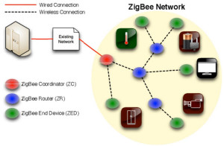

Slide 52
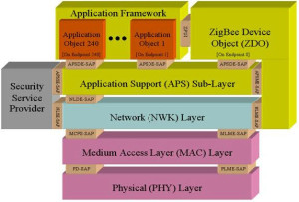

Slide 53
Different layers
Physical Layer: This layer does modulation and demodulation operations up on transmitting and receiving signals respectively. This layer’s frequency, date rate and number of channels are given below.
MAC Layer: This layer is responsible for reliable transmission of data by accessing different networks with the carrier sense multiple access collision avoidance (CSMA). This also transmits the beacon frames for synchronizing communication.
Network Layer: This layer takes care of all network related operations such as network setup, end device connection and disconnection to network, routing, device configurations, etc.
Application Support Sub-Layer: This layer enables the services necessary for Zigbee device object and application objects to interface with the network layers for data managing services. This layer is responsible for matching two devices according to their services and needs. This application, ZDO, keeps track of the state of the Zigbee device on and off the network, and provides an interface to the Zigbee Device Profile (ZDP), a specialized Application Profile for discovering, configuring, and maintaining Zigbee devices and services on the network.
Application Framework: It provides two types of data services as key value pair and generic message services. Generic message is a developer defined structure, whereas the key value pair is used for getting attributes within the application objects. ZDO provides an interface between application objects and APS layer in Zigbee devices. It is responsible for detecting, initiating and binding other devices to the network.

Slide 54
Zigbee Operating Modes and Its Topologies
Zigbee two way data is transferred in two modes: Non-beacon mode and Beacon mode.
In a beacon mode, the coordinators and routers continuously monitor active state of incoming data hence more power is consumed.
In this mode, the routers and coordinators do not sleep because at any time any node can wake up and communicate.
However, it requires more power supply and its overall power consumption is low because most of the devices are in an inactive state for over long periods in the network.

Slide 55
In a beacon mode, when there is no data communication from end devices, then the routers and coordinators enter into sleep state. Periodically this coordinator wakes up and transmits the beacons to the routers in the network. These beacon networks are work for time slots which means, they operate when the communication is needed which results in lower duty cycles and longer battery usage. These beacon and non-beacon modes of Zigbee can manage periodic (sensors data), intermittent (Light switches) and repetitive data types.

Slide 56
Zigbee Topologies
Zigbee supports several network topologies; however, the most commonly used configurations are star, mesh and cluster tree topologies. Any topology consists of one or more coordinator. In a star topology, the network consists of one coordinator which is responsible for initiating and managing the devices over the network. All other devices are called end devices that directly communicate with coordinator. This is used in industries where all the end point devices are needed to communicate with the central controller, and this topology is simple and easy to deploy.
In mesh and tree topologies, the Zigbee network is extended with several routers where coordinator is responsible for staring them. These structures allow any device to communicate with any other adjacent node for providing redundancy to the data. If any node fails, the information is routed automatically to other device by these topologies. As the redundancy is the main factor in industries, hence mesh topology is mostly used.
In a cluster-tree network, each cluster consists of a coordinator with leaf nodes, and these coordinators are connected to parent coordinator which initiates the entire network.

Slide 57
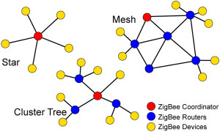

Slide 58
Security
Security and data integrity are key benefits of the ZigBee technology. ZigBee leverages the security model of the IEEE 802.15.4 MAC sublayer which specifies four security services:
access control the device maintains a list of trusted devices within the network
data encryption, which uses symmetric key 128-bit advanced encryption standard
frame integrity to protect data from being modified by parties without cryptographic keys
sequential freshness to reject data frames that have been replayed the network controller compares the freshness value with the last known value from the device and rejects it if the freshness value has not been updated to a new value

Slide 59
Wi-Fi
Wi-Fi is the name of a wireless networking technology that uses radio waves to provide wireless high-speed Internet and network connections. A common misconception is that the term Wi-Fi is short for "wireless fidelity," however this is not the case. Wi-Fi is simply a trademarked phrase that means IEEE 802.11x.
Wi-Fi networks have no physical wired connection between sender and receiver by using radio frequency (RF) technology -- a frequency within the electromagnetic spectrum associated with radio wave propagation. When an RF current is supplied to an antenna, an electromagnetic field is created that then is able to propagate through space.
It is a technology for wireless local area networking with devices based on IEEE 802.11 standards. Wi-Fi compatible devices can connect to the internet via WLAN network and a wireless access point abbreviated as AP. Every WLAN has an access point which is responsible for receiving and transmitting data from/to users. IEEE has defined certain specifications for wireless LAN, called IEEE 802.11 which covers physical and data link layers.
Wi-Fi allows networking of computers and digital devices without the need for wires. Data is transferred over radio frequencies, allowing Wi-Fi capable devices to receive and transmit data when they are in range of a Wi-Fi network.
The widespread use of the technology and its availability in both residential homes and public places – including parks, gathering spots, and coffee shops – have made it one of the most popular data transmission technologies available today.

Slide 60
The Technology Behind Wi-Fi
Wi-Fi uses a radio technology known as 802.11, which can transmit data over short distances using high frequencies. 802.11 operates on either 2.4GHz or 5GHz depending on its type. The network’s central point is the access point, which is a router with transmitting antennas which route the transfer of data.
Typically, the range of this Wi-Fi access point to any Wi-Fi capable devices is about 300 feet outdoors and 150 feet indoors. This estimated range does not take into account any obstructions which may block the signal, including walls, solid objects or trees. The more obstructions in the signal’s path from the base station, the shorter the range will be.

Slide 61
The architecture of this standard has 2 kinds of services: 1. BSS (Basic Service Set) 2. ESS (Extended Service Set) BSS is the basic building block of WLAN. It is made of wireless mobile stations and an optional central base station called Access Point. Stations can form a network without an AP and can agree to be a part of a BSS. A BSS without an AP cannot send data to other BSSs and defines a standalone network. It is called Ad-hoc network or Independent BSS(IBSS).i.e A BSS without AP is an ad-hoc network. A BSS with AP is infrastructure network.

Slide 62
Different Types of Wi-Fi
Currently there are four major types of Wi-Fi, known as 802.11a, 802.11b, 802.11g, and 802.11n. The two most common and oldest types are 802.11b and g, which operate at a frequency of 2.4GHz. 802.11b has a theoretical maximum transmission speed of about 11Mbps, while 802.11g can transmit data at speeds up to 54Mbps.
802.11a was the next version of Wi-Fi developed, and it operated on a frequency of 5GHz and allowed data transmission at speeds of up to 54Mbps. It is not backwards compatible with 802.11b or g, due to its operation on a different frequency, thus limiting its use.
802.11n is the newest version of the technology and it is backwards compatible with devices running 802.11b or g. It operates at speeds up to 450Mbps on either 2.4GHz or 5GHz, either on a single channel or two channels. On dual channel devices, data transmission can theoretically exceed 450Mbps limit.

Slide 63
Limitations of Wi-Fi
Obstructions in the path of a Wi-Fi signal will limit its range. In addition, maximum speeds are only attainable in locations close to the base station. As the signal quality decreases, so will the maximum speed.
Wi-Fi is also susceptible to interference from the many devices that operate at the same frequency. This includes Bluetooth devices, cordless phones and microwaves. It is recommended that these devices should be operated at a distance from the base station in order to minimize interference.

Slide 64
Access Point(AP) is a wireless LAN base station that can connect one or many wireless devices simultaneously to internet.

Slide 66
ESS is made up of 2 or more BSSs with APs. BSSs are connected to the distribution system via their APs. The distribution system can be any IEEE LAN such as Ethernet. ESS has 2 kinds of stations:
Mobile – stations inside the BSS 2. Stationary – AP stations that are part of wired LAN.

Slide 68
The topmost green box represents the distribution system and the other 2 green boxes represent the APs of 2 BSSs.

Slide 69
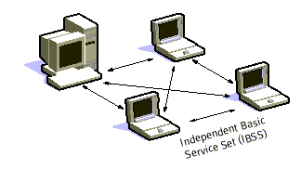

Slide 70
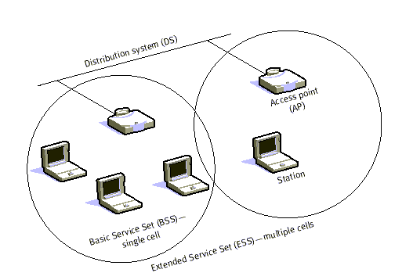

Slide 71
Cellular Network Organization
Use multiple low-power transmitters (100 W or less)
Areas divided into cells
Each served by its own antenna
Served by base station consisting of transmitter, receiver, and control unit
Band of frequencies allocated
Cells set up such that antennas of all neighbors are equidistant (hexagonal pattern)

Slide 72
Frequency Reuse
Adjacent cells assigned different frequencies to avoid interference or crosstalk
Objective is to reuse frequency in nearby cells
10 to 50 frequencies assigned to each cell
Transmission power controlled to limit power at that frequency escaping to adjacent cells
The issue is to determine how many cells must intervene between two cells using the same frequency

Slide 73
Frequency Assignment Problems
Cellular systems provider allocates frequencies from a licensed spectrum
Constraints:
For any cell, interference from nearby cells within an acceptable minimum
For any cell, the frequency bandwidth allocated sufficient to support the load in the cell
Objectives:
Minimize the total bandwidth (or width of the spectrum) allocated across all cells
Minimize call blocking probability
Minimize average interference

Slide 74
